Slide 1

Graph Neural Networks for FC Fingerprinting
Members: Thomas Muha
Advisor: Gowtham Atluri

Slide 2

Goals
Main Goal:
Apply GNNs to the FC fingerprinting task
Sub-Goals:
Implement the GMN
Described in Dullien et al.
Implement the Siamese GCN
Described in Ahmed et al.
Apply to FC fingerprinting
Compare network performance

Slide 3
Background – Functional Connectome (FC)
Connectome:
Functional Connectome:
Brain activity read by fMRI
BOLD signals: blood activity
FC is a correlation matrix of blood activity
Entry represents correlation between two nodes
Representation of brain connectivity

Slide 4
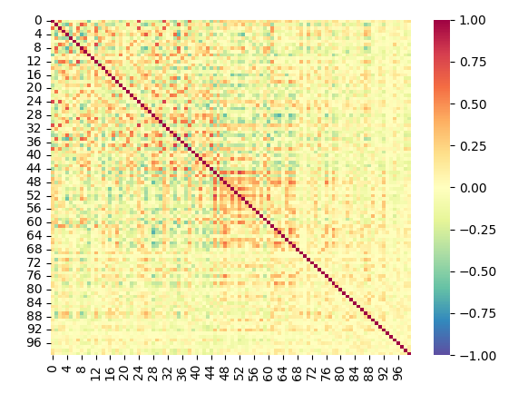
Background – FC Fingerprinting
Identify whether two FCs belong to same subject or different subjects
FC can be interpreted as adjacency matrix for a graph
Graph neural networks are a natural choice

Slide 5
Background – Graph Neural Networks
Use message passing and aggregation
Accumulate information nodes
Can predict on nodes, edges, or graph
GNNs used in this project:
Graph matching networks (GMNs)
Siamese graph convolutional networks (S-GCNs)

Slide 6
Intellectual Merits
Application of GNNs to FC fingerprinting
Direct comparison of GMN and S-GCN
Implementing GMN and S-GCN from scratch
GMN repository: Graph-Matching-Networks
No implementation of S-GCN found

Slide 7
Broader Impacts
Precision psychiatry uses connectomes for specific diageneses
GNNs can be used to differentiate subjects
Potential to identify disease, show patterns
Comparing GNN architectures on FC data

Slide 8
Design Specifications – Graph Matching Networks

Slide 9
Graph Matching Networks
The GMN takes two graphs and returns embeddings for each graph
GMNs use a node propagation and aggregation model
Propagation Layers
Aggregator
Graph 1
Embedding 1
Attention
Propagation Layers
Aggregator
Graph 2
Embedding 2

Slide 10
Design Specifications – Siamese Graph Convolutional Networks

Slide 11
Siamese Graph Convolutional Networks
Pair of graphs to a similarity value
Each branch is a GCN
Dot product layer combines features
Similarity layer maps to a similarity value
GCN
FC 1
Output Features
Dot Product
Layer
Similarity
Layer
Combined Outputs
Similarity
Value
GCN
FC 2
Output Features

Slide 12
Technologies
Python
Networks created in PyTorch
NumPy: data processing and manipulation
Seaborn and Matplotlib: plotting results, visualizing data
Google Colab: training models

Slide 13
Results
Networks trained/evaluated with 5-fold cross validation:
MLP
GMN
S-GCN
HS-GCN
MLP used as baseline

Slide 14
Results
A MLP on its own performs well on FC fingerprinting
GMN only slightly better than MLP – underperformed
The GCN performs well
No significant gain over S-GCN with using the higher-order information in the HS-GCN
Model | Accuracy
MLP | 0.852 ± 0.005
GMN | 0.861 ± 0.010
S-GCN | 0.948 ± 0.003
HS-GCN | 0.952 ± 0.005

Slide 15
Challenges
Building the models
Prior PyTorch experience was limited
Training the models
Unstable training
Reading research papers
Challenge early in the project
Many unfamiliar concepts

Slide 16
Challenge – Issues in GMN
Training significantly longer than GCN
Performance lower than MLP
Possible explanations:
Overly complex implementation
Error in implementation

Slide 17

What I Learned
PyTorch experience
Reading and understanding research papers
More experience training models
Applying deep learning to a problem

Slide 18
References
Deep Graph Similarity Learning for Brain Data Analysis. Guixiang Ma, Nesreen K. Ahmed, Theodore L. Willke, Dipanjan Sengupta, Michael W. Cole, Nicholas B. Turk-Browne, and Philip S. Yu. 2019. https://doi.org/10.1145/3357384.3357815
Graph Matching Networks for Learning the Similarity of Graph Structured Objects. Li, Y., Gu, C., Dullien, T., Vinyals, O., and Kohli, P. (2019). https://arxiv.org/abs/1904.12787
Feature selection framework for functional connectome fingerprinting. Li K., Wisner K., Atluri G. Hum Brain Mapp. 2021;42:3717–3732. https://doi.org/10.1002/hbm.25379

Slide 19
Thanks!

